Slide 1
COLORADO - PRELIMINARY NRCS CONSERVATION PRACTICE ATMOSPHERIC BENEFITS, CO-BENEFITS AND ANCILLARY BENEFITS
Developed by Adam Chambers
Adam.chambers@usda.gov
503-320-9114

Slide 2
Colorado Conservation Practices Analyzed Focus on Soil Health in Cropland and Grazing Systems

Slide 3
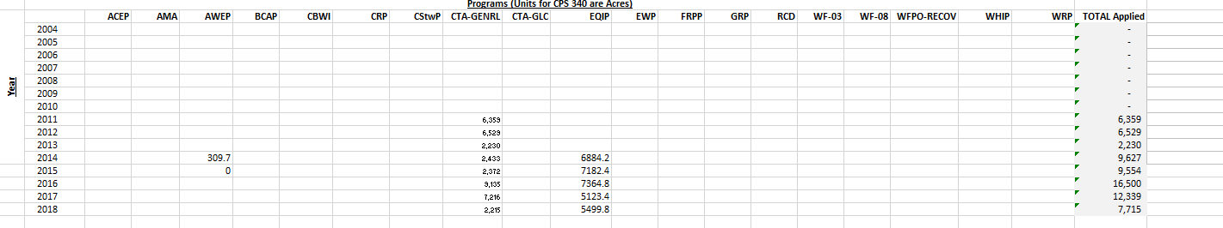

Slide 4
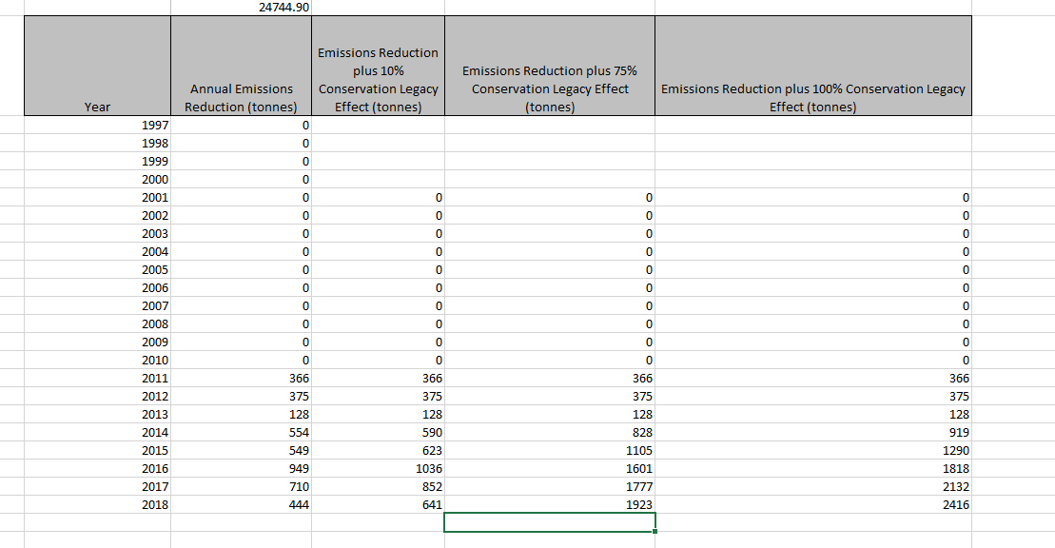

Slide 5
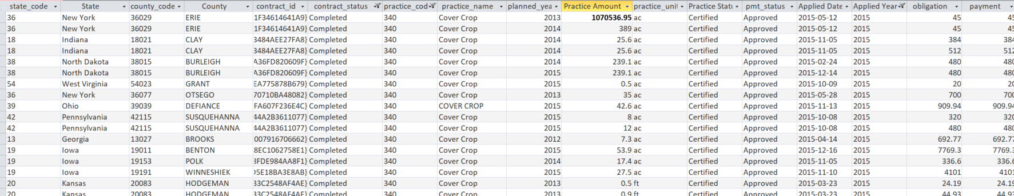

Slide 6
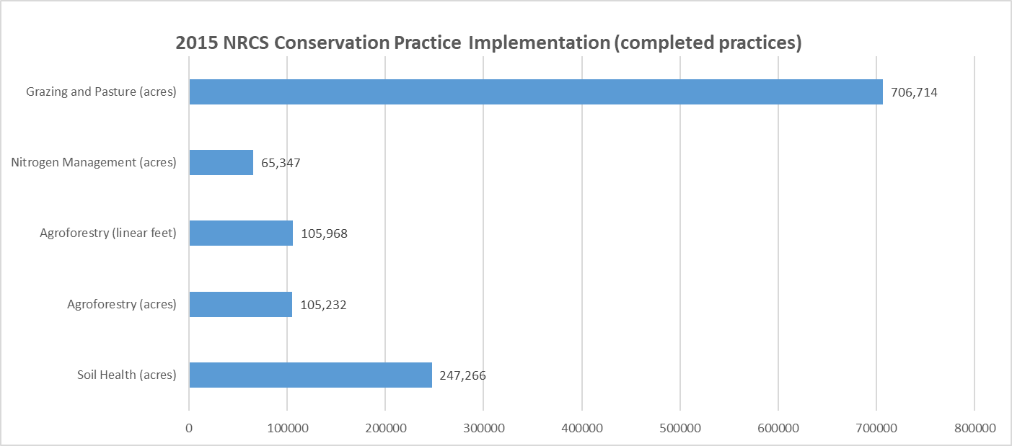
NRCS Conservation Practices Implemented in Colorado (2015 sample)

Slide 7
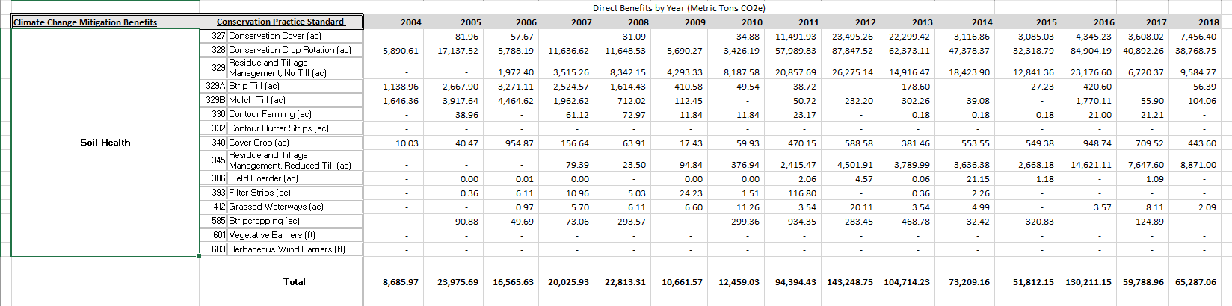
Direct Atmospheric and Soil Health Benefits of Cropland in Colorado – Data Compiled by NRCS

Slide 8
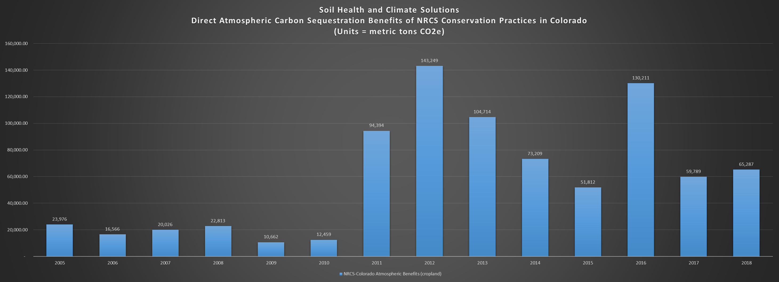
Direct Atmospheric and Soil Health Benefits of Cropland in Colorado – Data Compiled by NRCS

Slide 9
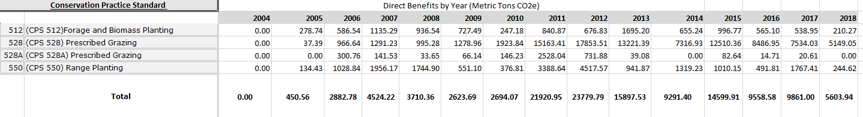
Direct Atmospheric and Soil Health Benefits of Grazing Systems in Colorado – Data Compiled by NRCS

Slide 10
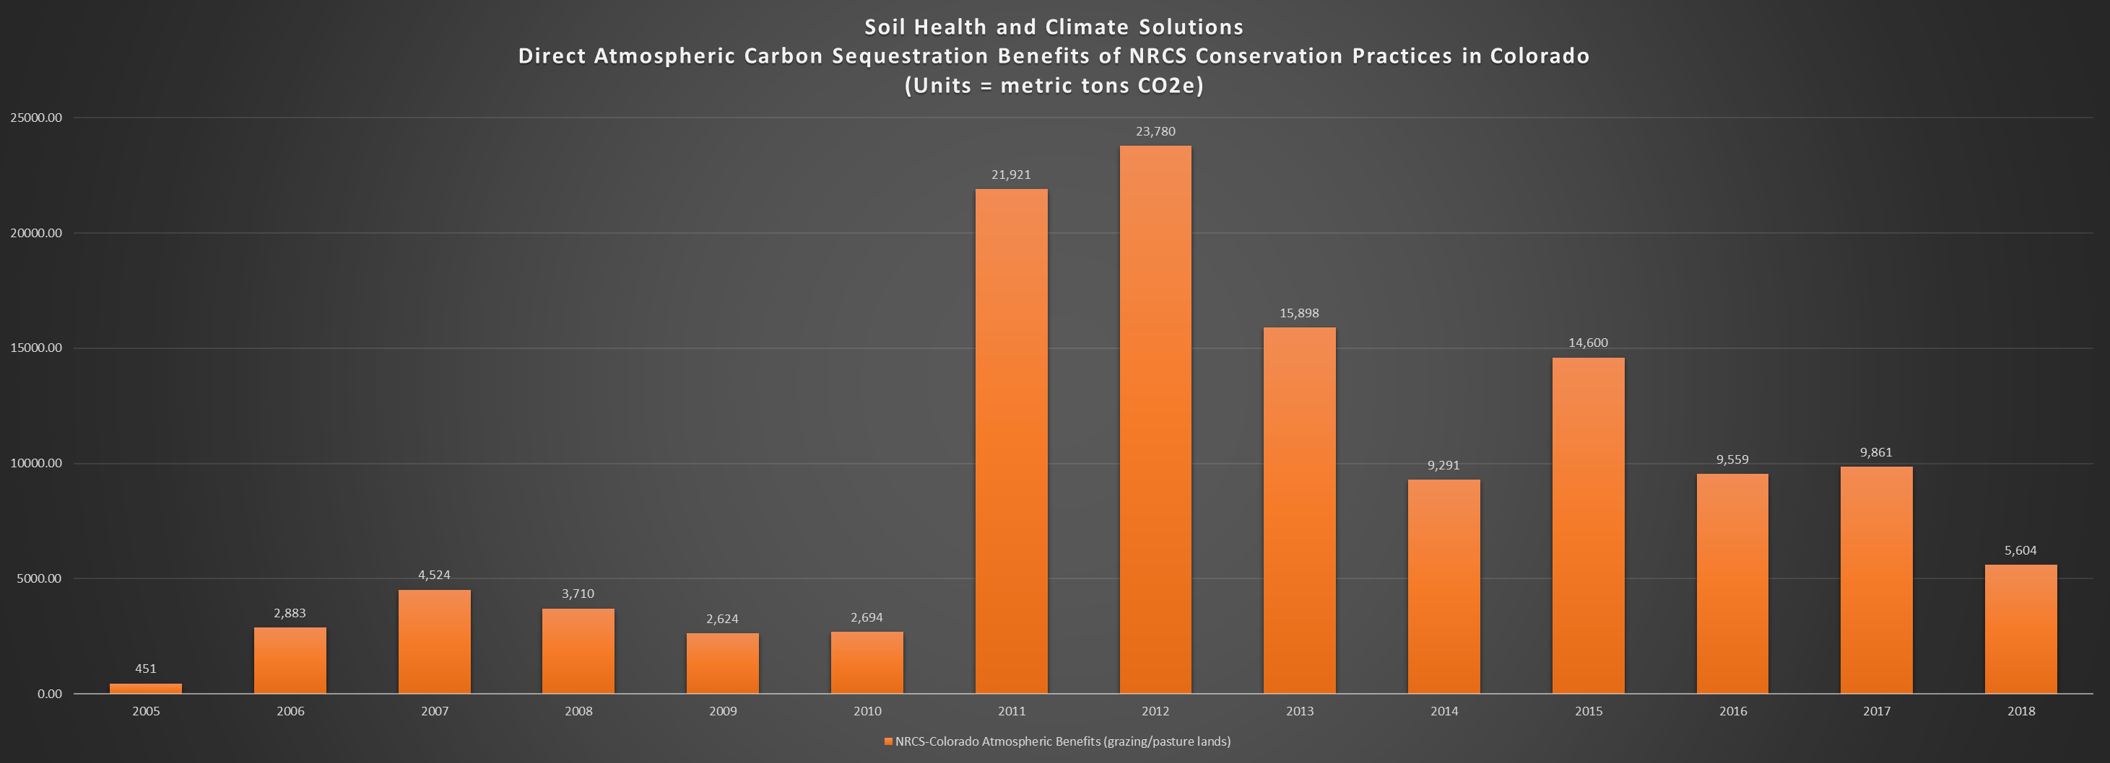
Direct Atmospheric and Soil Health Benefits in Grazing Systems in Colorado – Data Compiled by NRCS

Slide 11
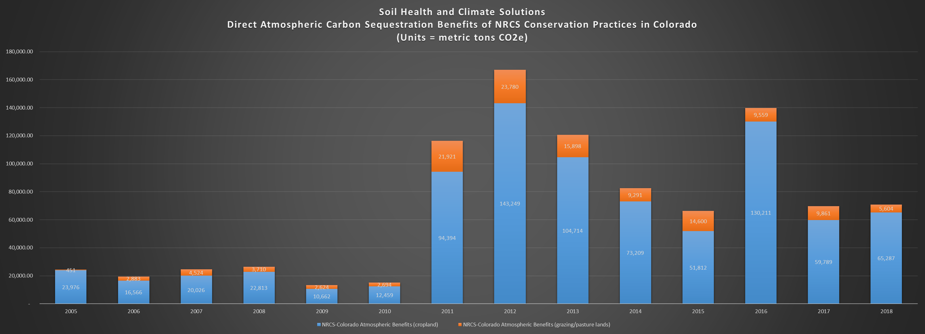
Direct Atmospheric and Soil Health Benefits of Cropland and Grazing Lands in Colorado – Data Compiled by NRCS

Slide 12
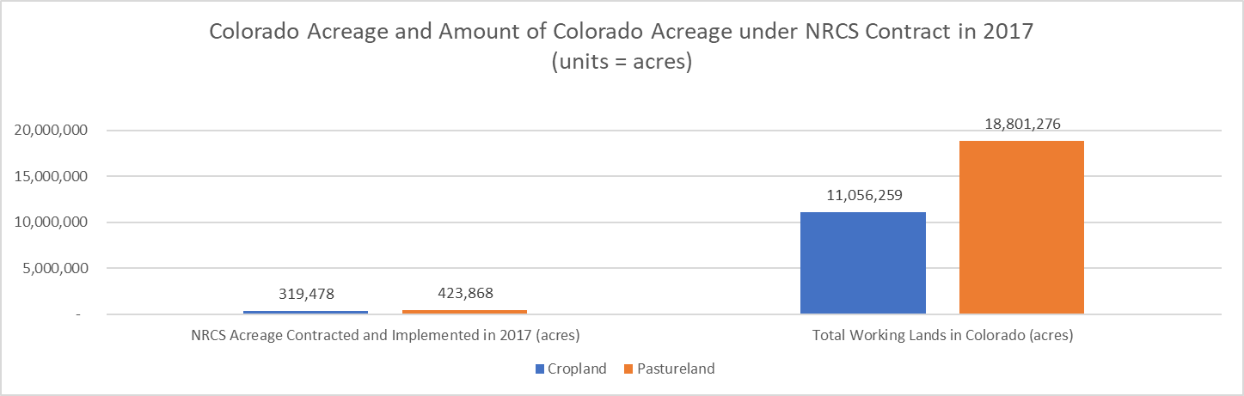
Working Lands Acreage under NRCS Contracts and Total Working Lands Acreage in Colorado (Data 2017 USDA NASS Census of Agriculture and NRCS Contract Data)

Slide 13
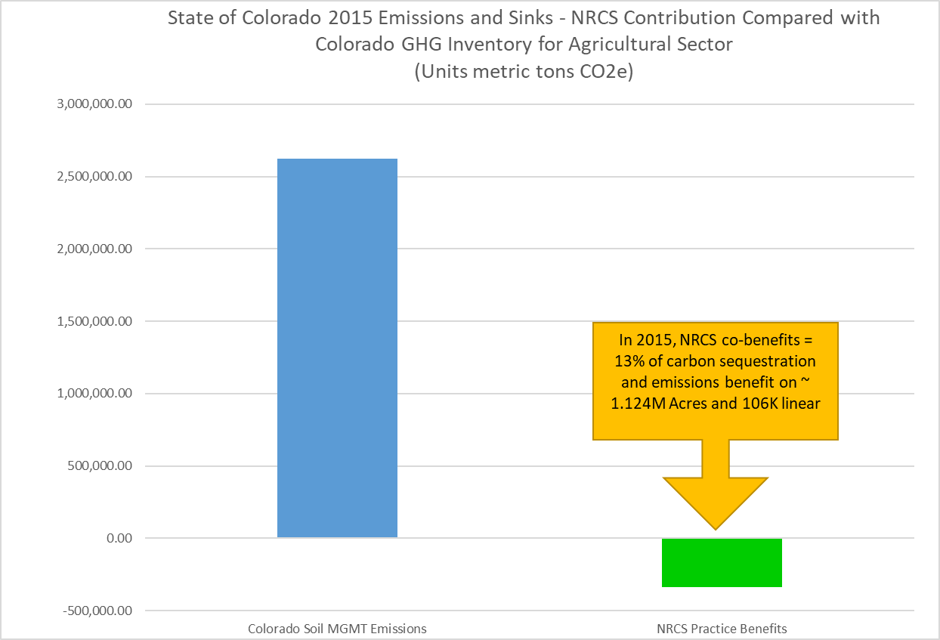
NRCS Benefits Paired With State of Colorado 2015 Inventory

Slide 14
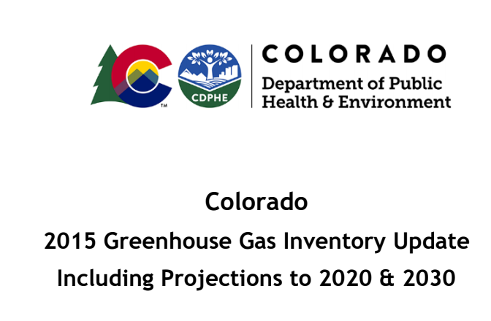
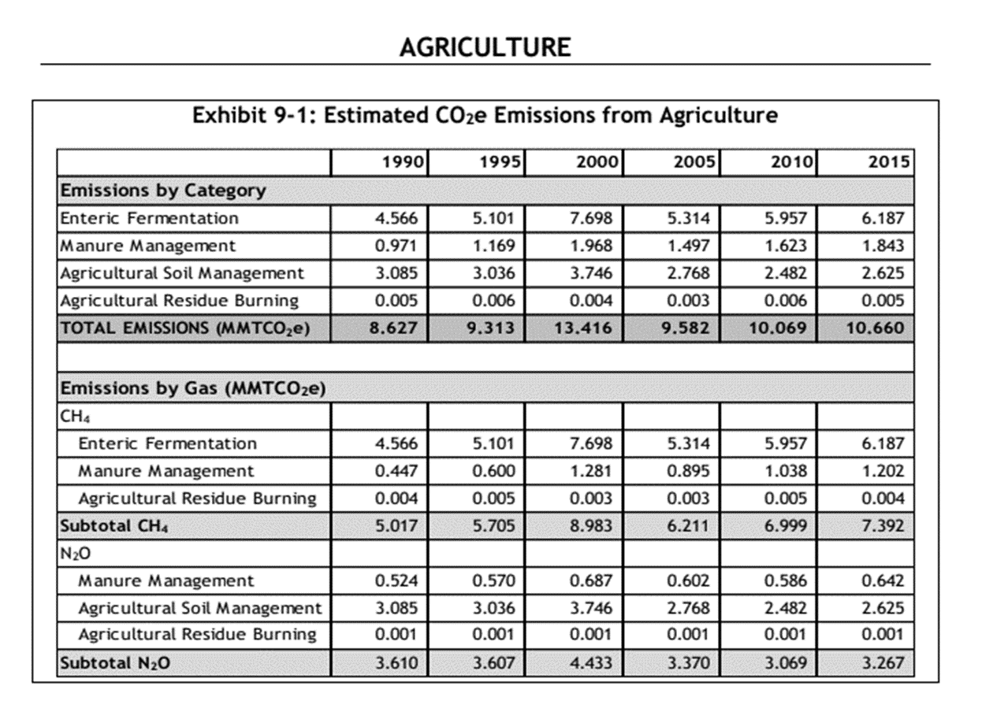
Colorado Greenhouse Gas Inventory

Slide 15
Takeaway Results – NRCS Climate-Smart Solutions
NRCS Voluntary Conservation Practices are Providing Atmospheric Benefits in Colorado
Direct Benefits from Carbon Farm Planning and Other Efforts
Co-Benefits for Implementing Conservation Practices
Ancillary Benefits when Conservation Practices are Installed for Other Purposes
NRCS can quantify these benefits and partners may find this interesting
NRCS also provides technical support and leadership in this area – State of Colorado government leverages this technical assistance

Slide 16
<END>
Preliminary and Deliberative Results
Thank You
Dr. Adam Chambers
Adam.chambers@usda.gov
503-320-9114

